Slide 1

Notes:
Bi folding door system

Slide 2
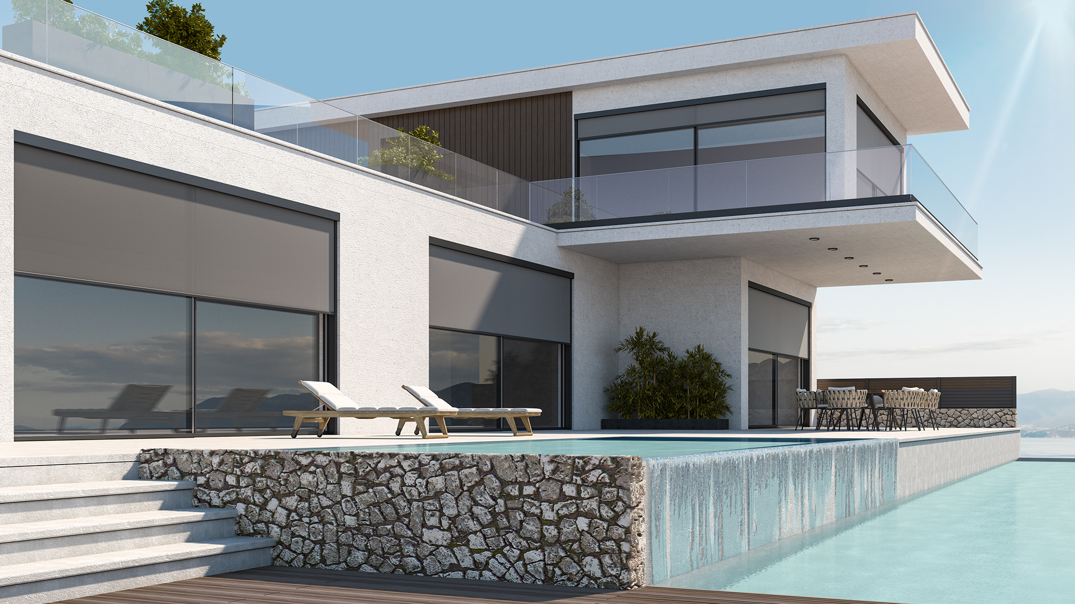


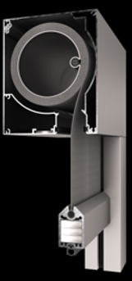
What
Electric fabric rollers with ZIP technology for optimal stretching, designed to provide efficient shading, enhancing simultaneously the building aesthetics.

Slide 3
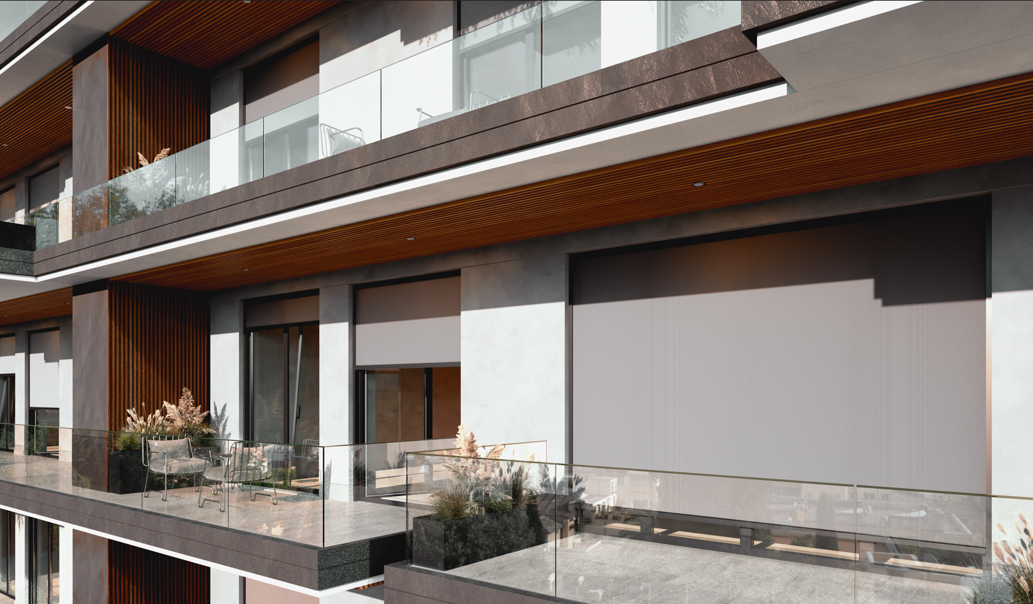
Application
Elegant shading and protection from solar radiation, suitable for application in modern residences and apartment buildings, as well as in commercial facilities and office buildings.

Slide 4
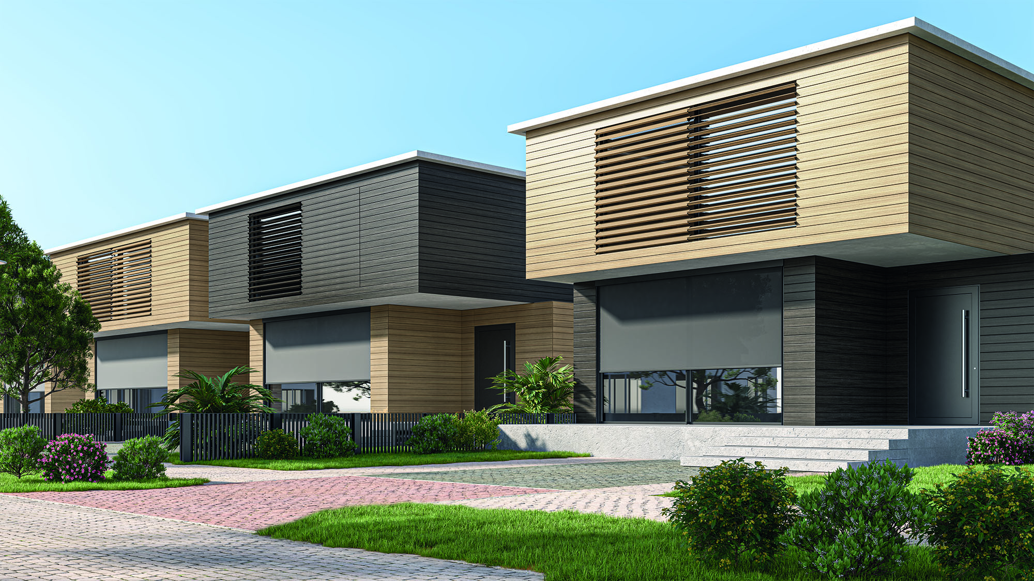
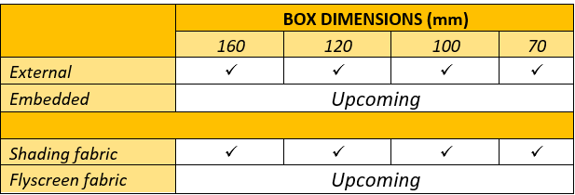
Range of solutions

Slide 5
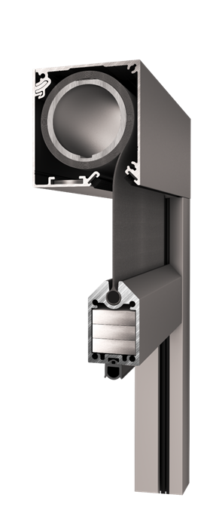
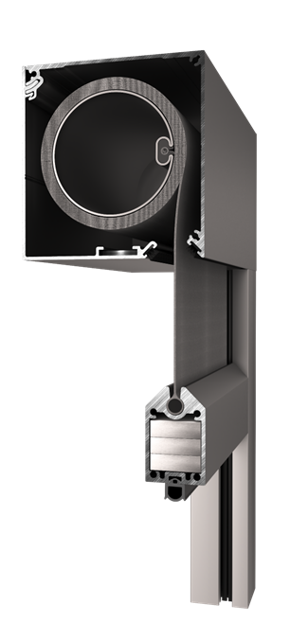
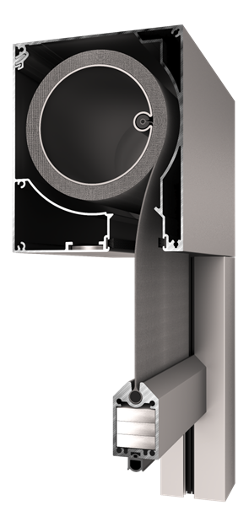
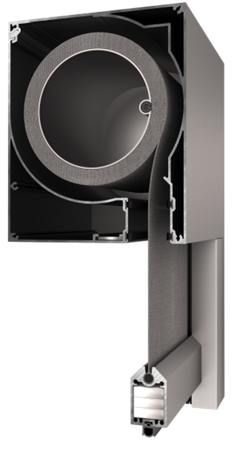
70mm 100mm 120mm 160mm

Slide 6
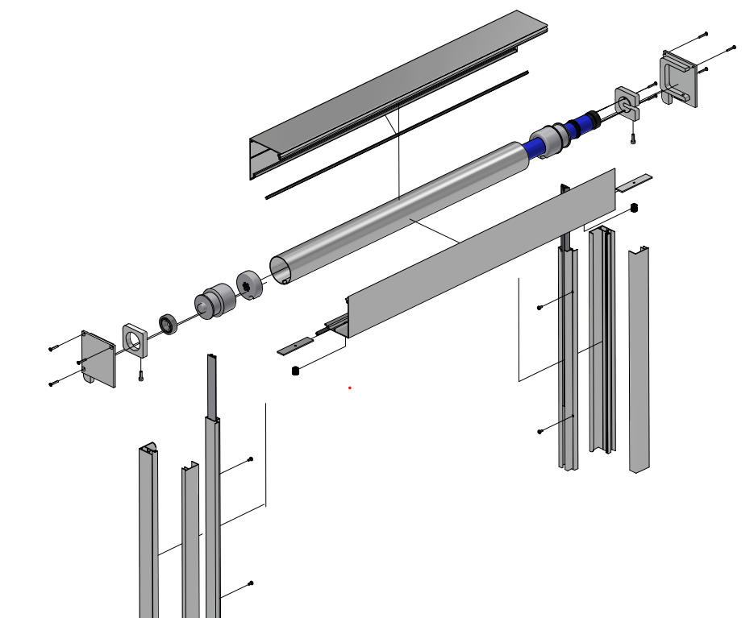
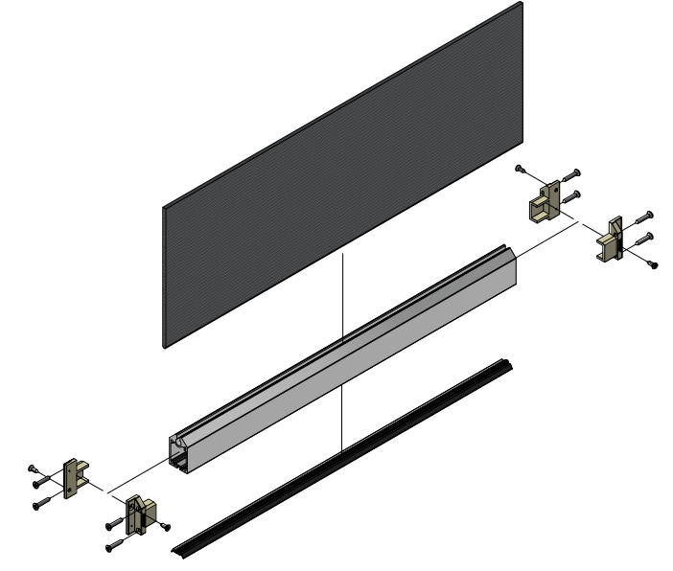
Steel reels (63, 78, 100mm, & 43mm (alum.)
Aluminium box accessible from the outer side
Aluminium side caps and fittings
Special plastic profiles for rail & reel adjustments
Steel beams for terminal profile

Slide 7
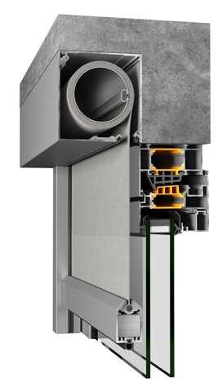
External Installation

Slide 8
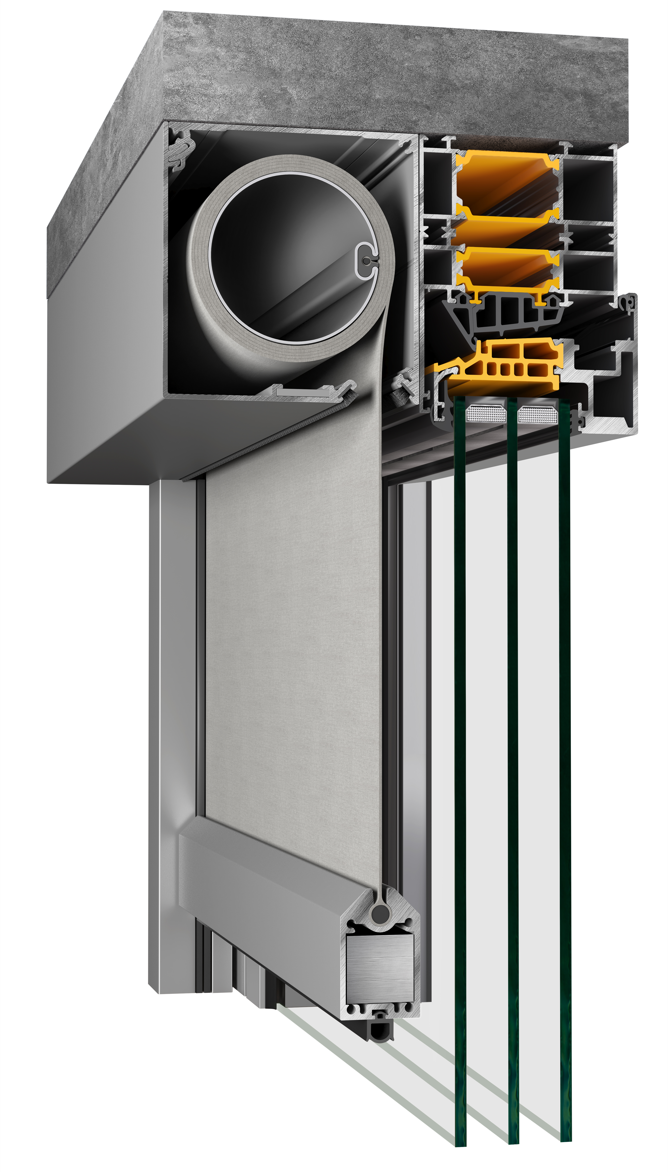
External Installation
adjacent to window frame

Slide 9
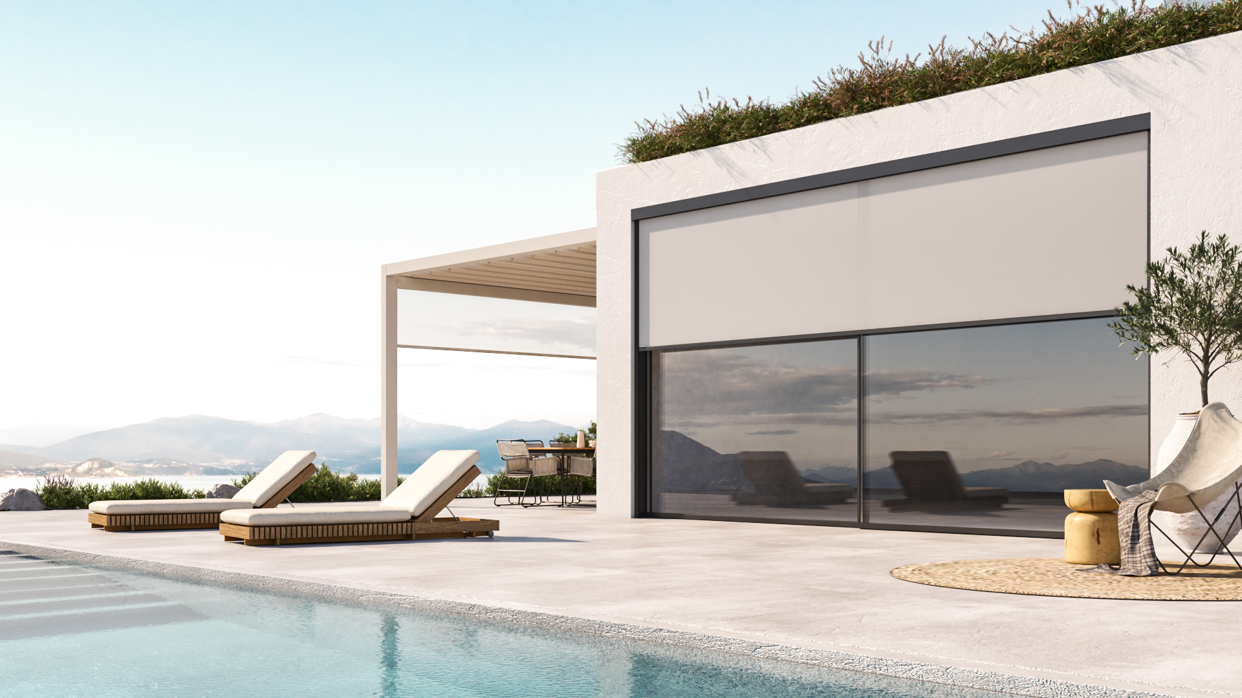
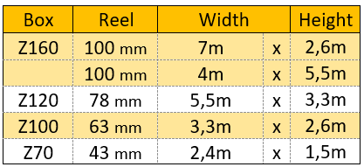
Max dimensions for shading fabrics

Slide 10
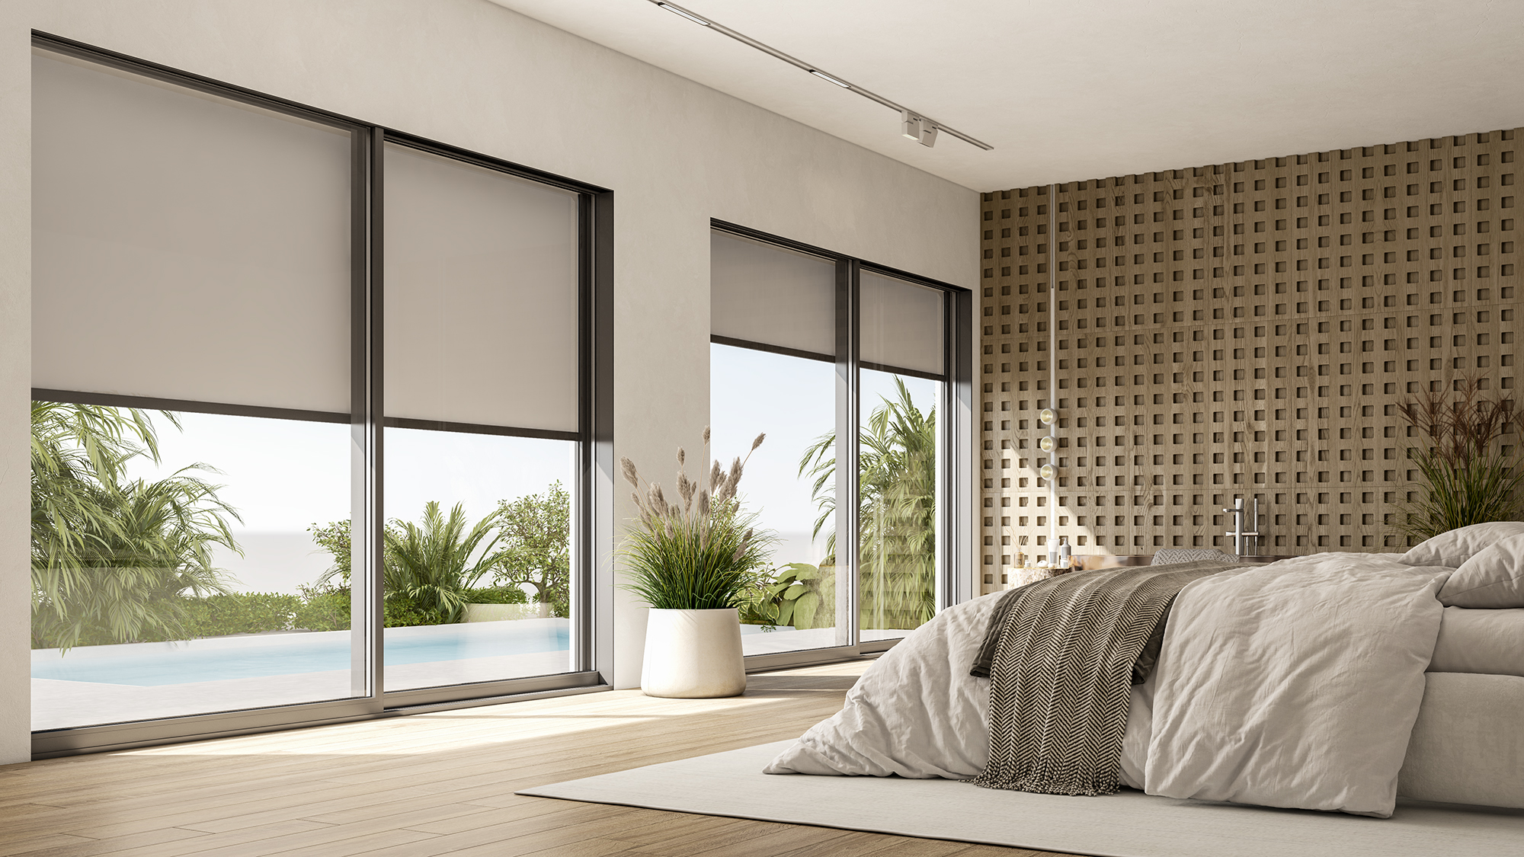
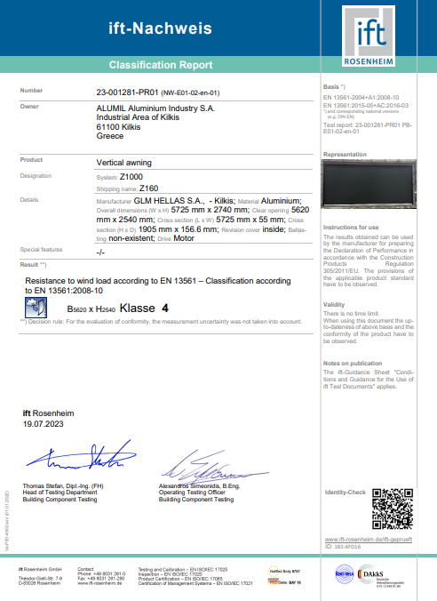
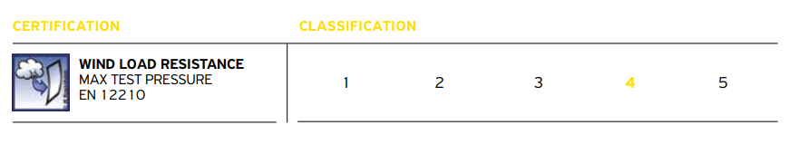
Certification
For dimensions (WxH) 5,7m x 2,7m

Slide 11
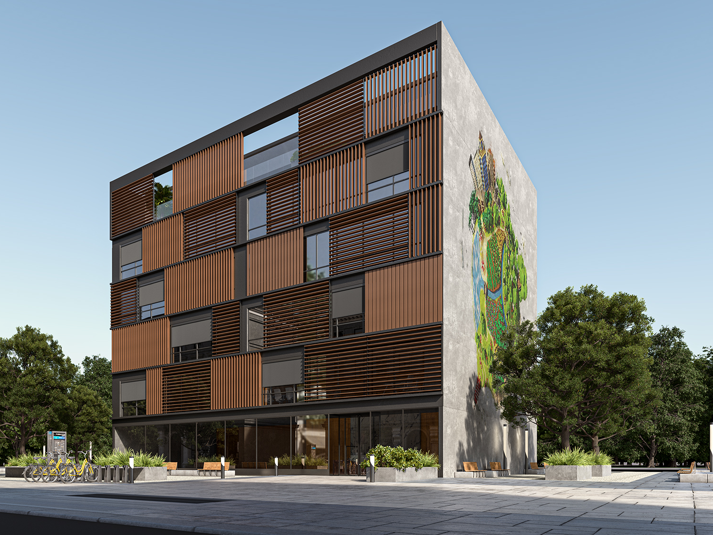
Benefits
Excellent solar protection
State-of-the-art fabrics that effectively shade and block harmful UV rays.
Enhanced thermal comfort
Maximum thermal comfort combined with excellent visibilty and breathability.
Energy efficiency
Minimal solar heat gains, reduced the need for extensive artificial cooling, yielding significant energy savings.
High aesthetics
Adds elegance and style, enhancing the aesthetics of any space, building.

Slide 12
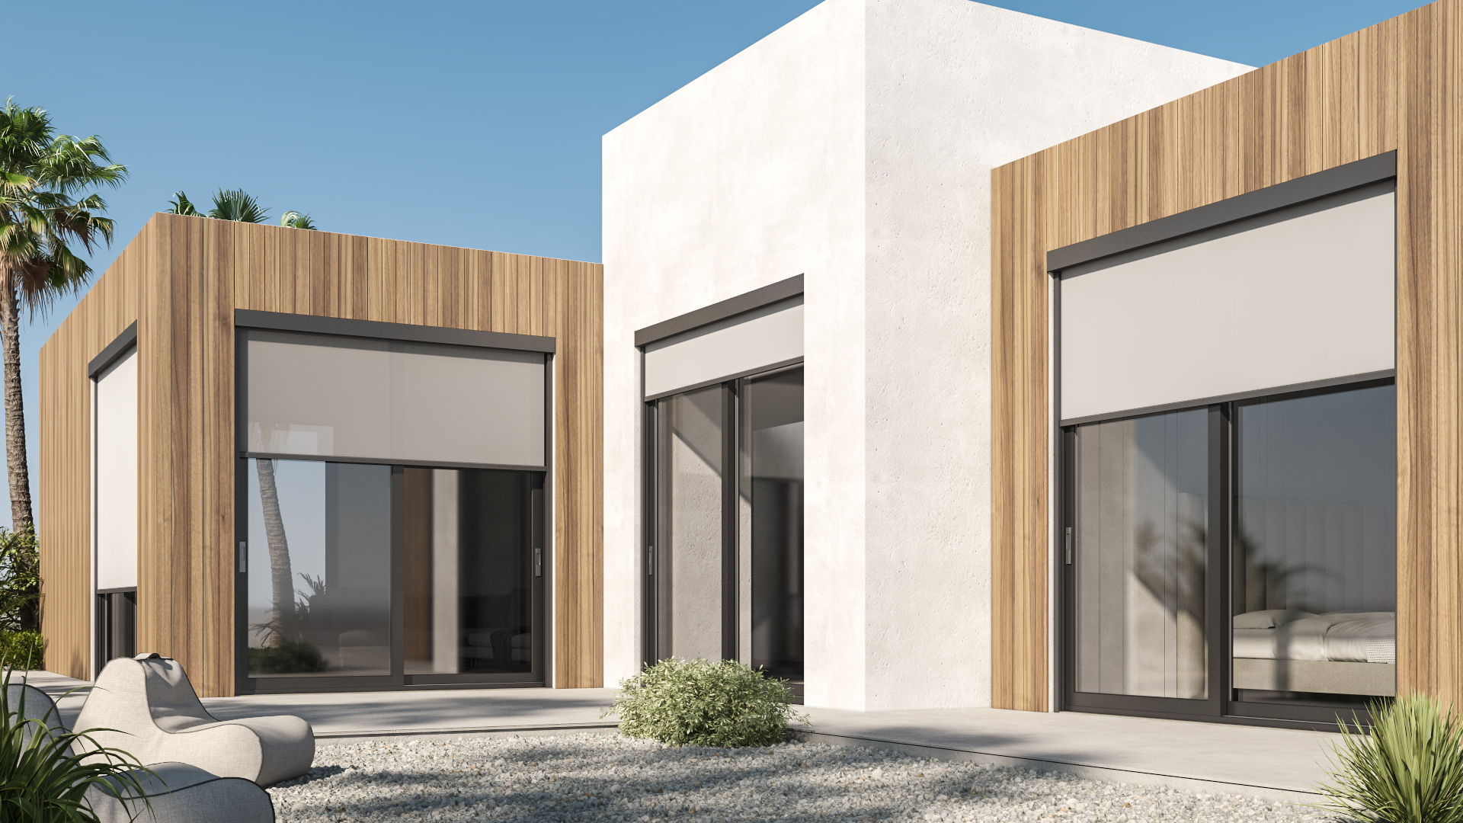
Customizable design
Wide range of colors, textures and finishes to seamlessly integrate with any window and facade.
Top quality and reliability
Exceptional durability and long-term functionality due to high-quality standards.
Privacy and blackout
Control over light transmission for desired privacy levels and darkening of internal space (blackout fabric).
Smart Home integration
Capability to connect with smart applications enabling easy control of shading and lighting.

Slide 13
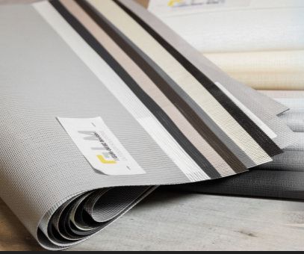
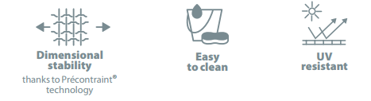
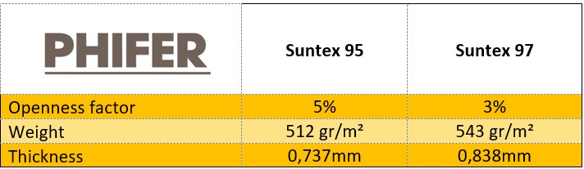
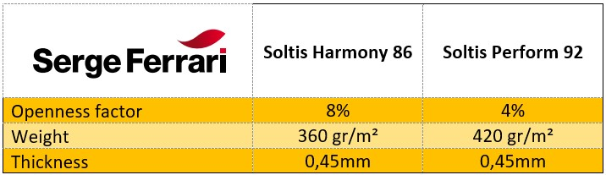
Shading Fabrics
Range of colours and textures
Up to 97% heat blocked
Up to 28% natural light transmission (TV)
High UV resistance
Glare control and excellent transparency
Fire-resistance certified- B-s2.d0
High fabric & colour resistance
Smooth finish and easy to clean

Slide 14
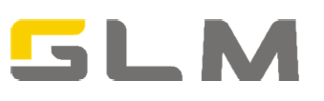
Available by GLM in prefabricated kit
Delivery time 4-6 weeks

Slide 15
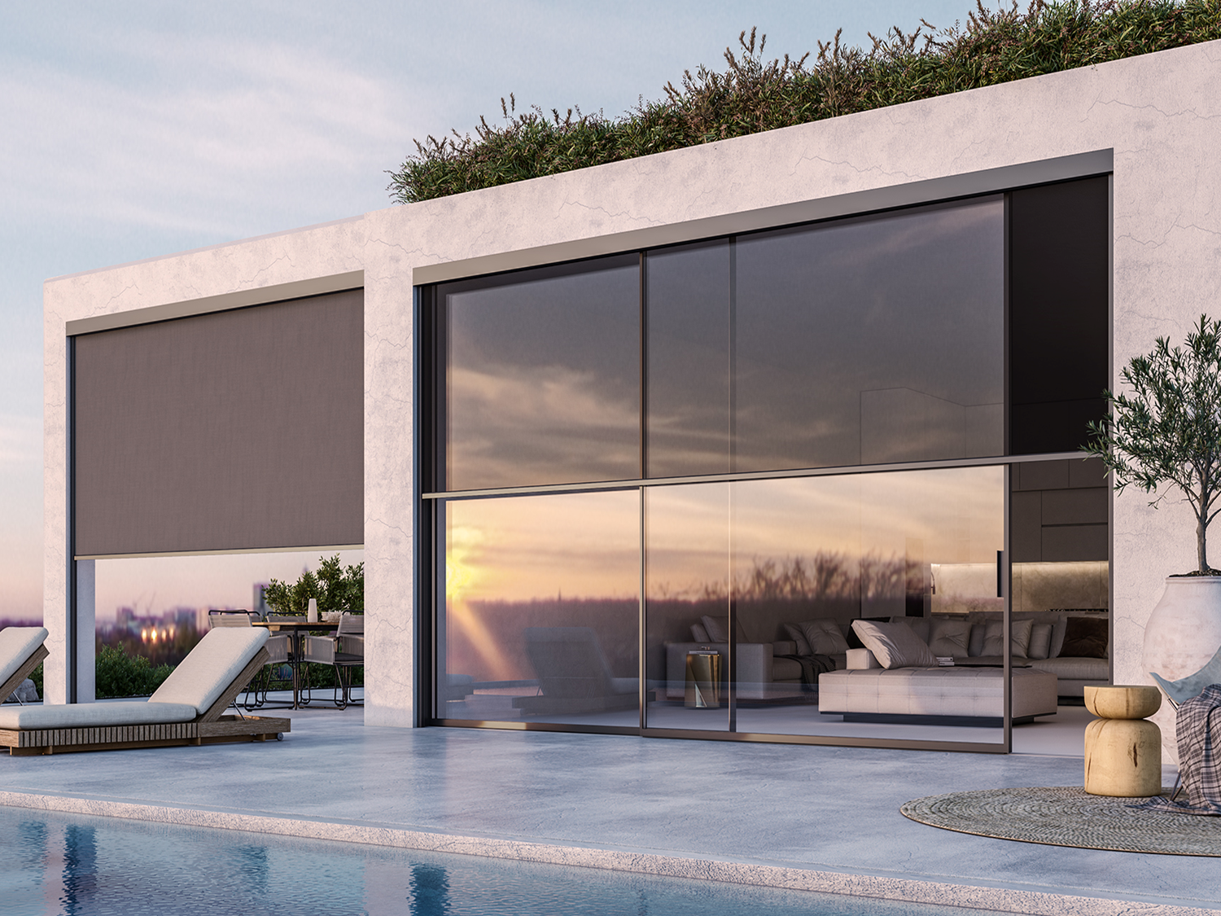
Thank you for your attention

